Slide 1














Smart Churn Prevention
Presented by Group - Insights

Slide 2

Churn prevention
Churn prevention is a proactive strategy aimed at reducing customer churn by leveraging data-driven insights and predictive analytics.
By employing personalized interventions and targeted engagement tactics, businesses can effectively mitigate churn risk and retain valuable customers. Ultimately, churn prevention enhances customer retention rates and fosters long-term loyalty, contributing to sustainable business growth and profitability.

Slide 3
Develop a robust churn modeling solution integrating advanced analytical techniques such as Linear Regression Support Vector Machines (SVM), Random Forest,, and Decision Trees.
01.
Goal of the Project
Generate actionable insights based on the churn modeling results to empower businesses with proactive strategies for improving customer retention.
02.
To develop a comprehensive churn modeling solution utilizing advanced analytical techniques and dimensionality reduction methods to provide actionable insights for businesses to improve customer retention strategies and reduce churn rates.
Aim to reduce churn rates by providing businesses with targeted recommendations and interventions informed by predictive analytics.
03.

Slide 4
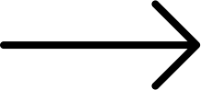
RowNumber
Tenure
CustomerId
Balance
Surname
NumOfProducts
Variables
HasCrCard
CreditScore
Geography
IsActiveMember
Exploring the dataset
Gender
EstimatedSalary
Age
Exited

Slide 5
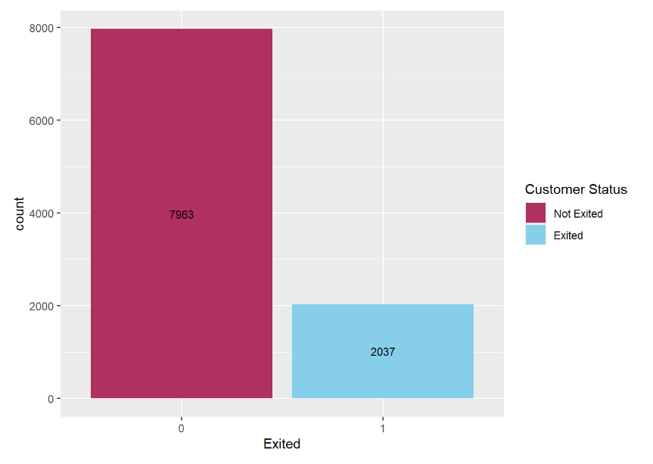
Problems with our Dataset
Our analysis reveals a significant imbalance in the dataset:
The majority of customers in the dataset have not exited, indicating a strong tendency towards customer retention.
Conversely, a smaller yet significant portion of customers have exited, underscoring potential challenges in service satisfaction or competitive offerings.

Slide 6
Exploratory Data Analysis

Slide 7
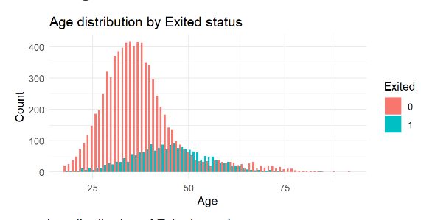
Observation: The bar plot illustrates distinct age distributions between customers who exited and those who stayed. Non-exited members display approximately gamma distribution, while exited members follow approximately a normal distribution.
Implication: The age distributions suggest age may influence churn behavior. Tailoring retention strategies based on age demographics, such as targeting younger customers with personalized offers, could help improve retention rates. Focusing on enhancing overall customer experience may be crucial for reducing attrition across different age groups. Further analysis is warranted to understand underlying factors driving churn within specific age cohorts.

Slide 8
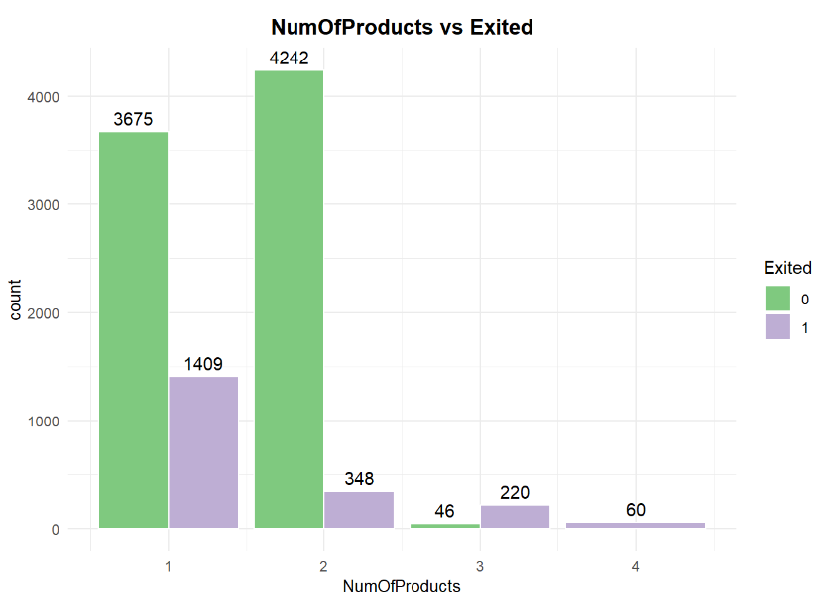
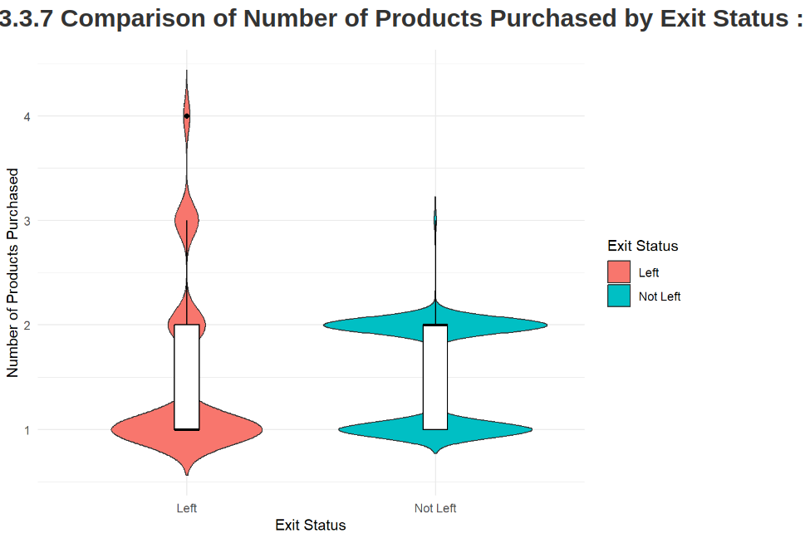
Observation: The bar plot indicates a clear correlation between the number of products held by customers and their likelihood to churn. Churn rates decrease as the number of products per customer increases.
Implication: To mitigate churn, businesses should focus on cross-selling and upselling strategies to encourage customers to hold multiple products. Additionally, addressing any pain points associated with specific product combinations can help improve overall customer retention rates.

Slide 9
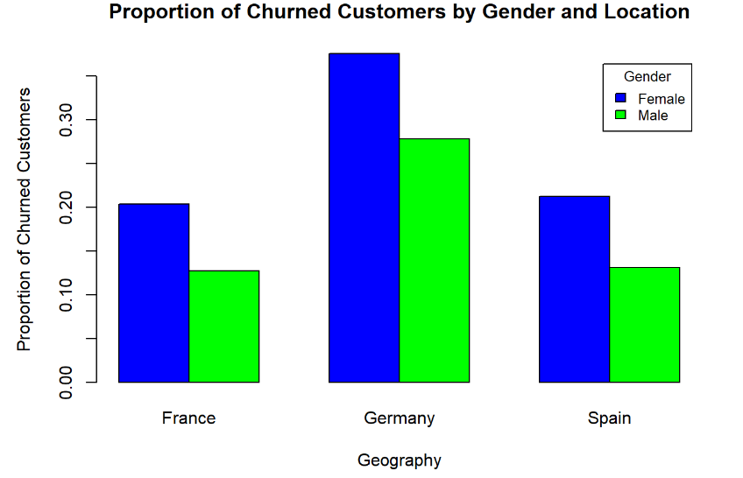
Observations:
Gender Disparity: The bar plot illustrates that across all three countries (Spain, France, Germany), Females exhibit a higher proportion of churn compared to males. This suggests a gender disparity in churn behavior, with females being more likely to exit the service.
Implications:
Gender-Sensitive Retention Strategies: Recognizing the gender disparity in churn rates underscores the importance of implementing gender-sensitive retention strategies. Tailoring retention efforts to address male customers' specific needs and preferences may be particularly crucial in mitigating churn.

Slide 10
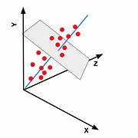
Principal Component Analysis
It is a statistical technique used for dimensionality reduction in multivariate data analysis. It works by transforming the original variables into a new set of orthogonal variables, known as principal components, which capture the maximum variance in the data. This enables a simplified representation of the data while retaining the most important information.
Following PCA, we scaled our variables to ensure that those with larger variances do not unduly influence the principal components. This scaling process is crucial as it helps prevent variables with higher variances from disproportionately contributing to the principal components, thereby ensuring a more balanced representation of the data in the subsequent analysis.

Slide 11
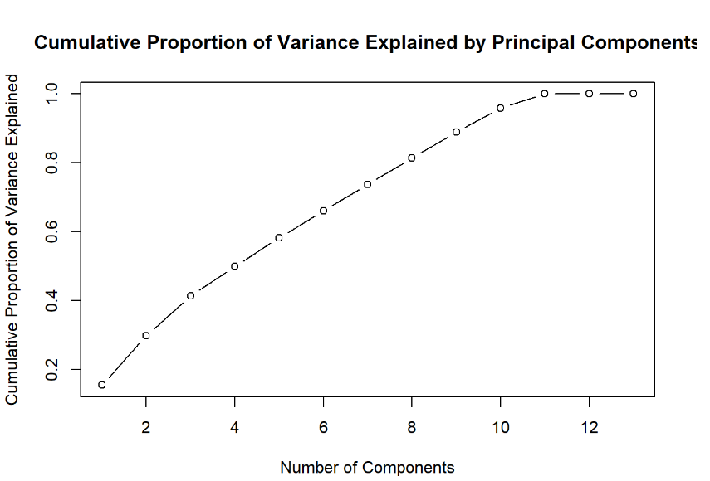
Our objective was to preserve 80 percent of the total variation. Hence, we will select the first 8 principal components, as they collectively explained the cumulative proportion of variance necessary to meet our predetermined threshold.

Slide 12
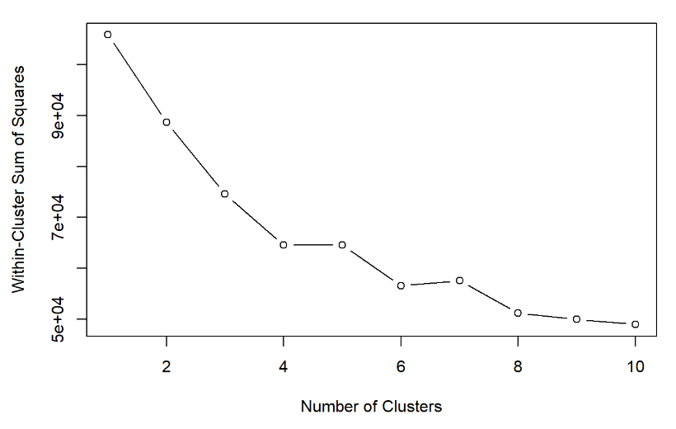
Clustering (K-MEANS)
K-means clustering is a popular unsupervised machine learning algorithm used for partitioning data into distinct groups or clusters based on similarity patterns among data points. It works by iteratively assigning each data point to the nearest cluster centroid and then recalculating the centroids based on the mean of the points assigned to each cluster.
So, our first goal is to identify the optimal number of clusters (“k”) for our dataset.
For this we have used ELBOW METHOD. We decided to go with 4 clusters.

Slide 13
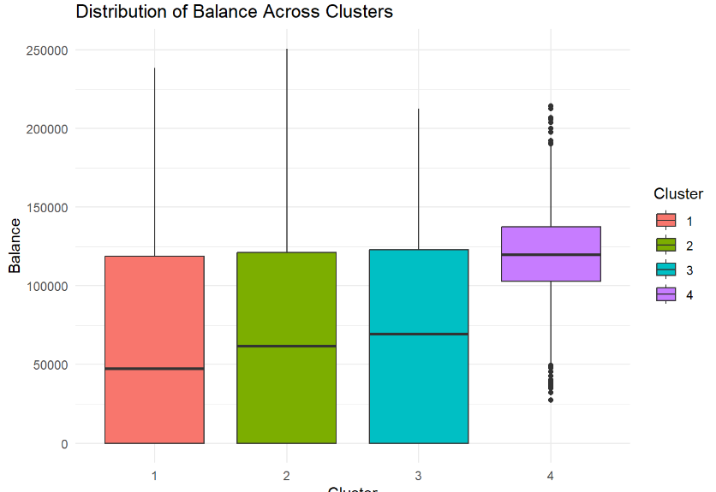
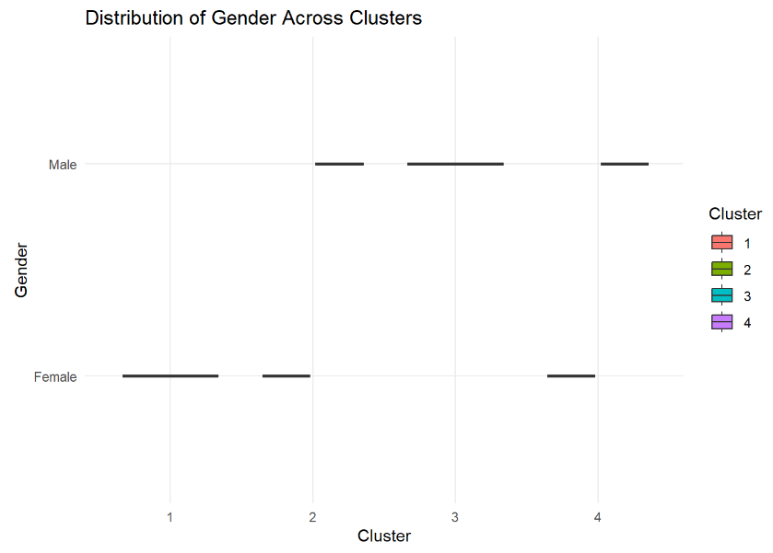

Slide 14
Sampling Methodology
Our analysis employs a two-step sampling approach for representativeness and reliability. We integrate Stratified Sampling with Simple Random Sampling Without Replacement (SRSWOR):
Stratified Sampling: We categorize the dataset based on key demographic indicators (Age) to preserve diversity. For instance, age groups like teenagers, young adults, middle-aged, and seniors ensure comprehensive representation.
SRSWOR: Random selection from each stratum without replacement ensures uniqueness and eliminates bias. This approach produces a representative and diverse sample across age segments, ensuring validity.
This combined approach captures population heterogeneity, enhancing accuracy and bolstering analytical integrity.

Slide 15
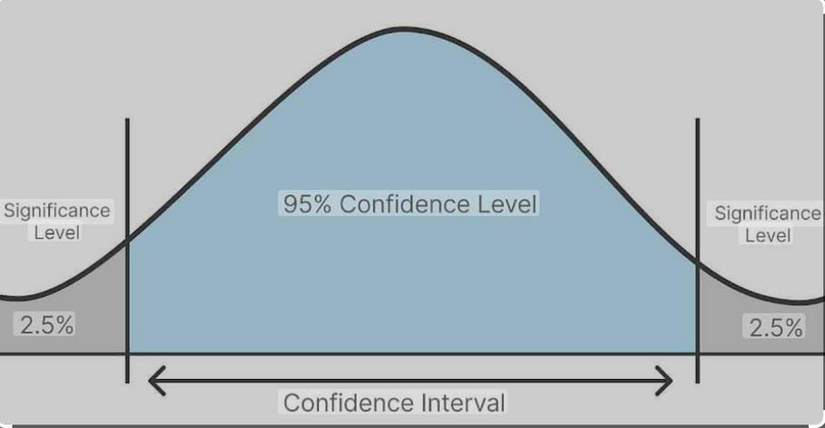
Confidence Interval
Using the sample that we have obtained, we calculate the confidence interval in which we expect the population churn rate to lie in with 95% confidence.
After calculation, the interval comes out to be [0.1707, 0.2199].

Slide 16
Hypothesis Testing
To demonstrate the concept of hypothesis testing, we make a hypothesis that 20% of all customers exit the program. The opposite of this hypothesis is another hypothesis that more than or less than 20% customers exit the program.
The first hypothesis is called the Null hypothesis and the second hypothesis is called the Alternate Hypothesis.
P-value: The p-value in statistics represents the probability of obtaining results as extreme as or more extreme than the observed results, assuming the null hypothesis is true. It serves as a measure to determine the strength of evidence against the null hypothesis in a hypothesis test. A smaller p-value suggests stronger evidence against the null hypothesis, leading to its rejection in favor of an alternative hypothesis.
For the sample we have obtained, the code calculates the P-value using the standard approach.
The P-value turns out to be: 0.7158385
The value is significant enough for us to not be able to reject the Null hypothesis.

Slide 17
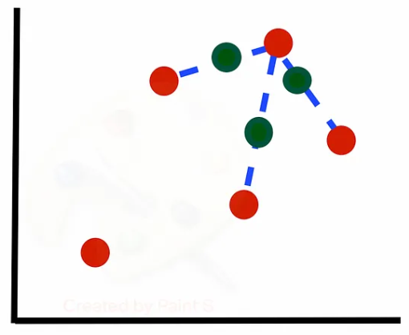
SMOTE
SMOTE tackles class imbalance in machine learning by generating synthetic samples for the minority class, balancing dataset distribution. It identifies nearest neighbors, creating synthetic instances along connecting lines until balance is achieved. This nuanced approach broadens feature space exploration, aiding models in learning generalized patterns and improving performance on imbalanced datasets. However, effectiveness relies on dense minority class instances and quality of original samples; sparse data or high dimensionality may compromise results. Overall, SMOTE enhances model accuracy by balancing class distribution through synthetic minority class examples.

Slide 18
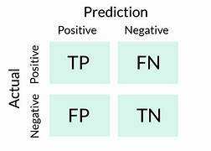
Confusion Matrix
why false negative is important ?
False negatives in a churn dataset are important because they represent cases where the model fails to predict customers who are likely to churn. This can lead to missed opportunities for retaining profitable customers and result in revenue loss for the company.

Slide 19
Best Model for Training
Model Name | Recall(%)
Logistic Regression Model | 69.38009
Decision Tree Model | 83.71947
SVM Model | 88.47840
Random Forest Model | 92.36068
We started with logistic regression and decision trees for churn prediction but faced challenges in achieving precise recall. To improve, we tried Support Vector Machine and Random Forest models known for capturing complex patterns. Random Forest model achieved the highest recall, so we chose it for churn prediction, enhancing our efforts and leading to better customer retention and business outcomes.

Slide 20
What is Random Forest ?
Confusion Matrix
Random Forest is an ensemble learning technique that combines multiple decision trees to improve predictive accuracy. It works by aggregating the predictions of individual decision trees, thereby reducing overfitting and improving generalization. In our case, the Random Forest model demonstrated superior performance in identifying churn instances, resulting in higher recall compared to other models.
ACTUAL PREDICTED | 1 | 0
1 | 1475 | 162
0 | 122 | 241
Accuracy Precision Recall Specificity F1 score
0.8580000 0.9010385 0.9236068 0.5980149 0.9121831

Slide 21
Conclusion
1. Understanding Churn Patterns: Through comprehensive analysis, we’ve identified key factors contributing to churn, including age, balance, number of products, gender, location, and active membership status. These insights enable us to tailor strategies effectively.
2. Targeted Marketing Strategies: Armed with knowledge about demographic and behavioral patterns, businesses can implement targeted marketing initiatives. This includes incentivizing active membership, personalized promotions, and retention efforts for specific customer segments.
3. Improving Customer Engagement: Proactive engagement with customers, particularly those exhibiting signs of potential churn such as low balances or inactive memberships, can significantly reduce churn rates. Personalized interactions and offers based on individual profiles can foster stronger customer relationships.

Slide 22
Conclusion
4. Enhanced Product Offerings: Recognizing the correlation between certain product features and churn rates suggests opportunities for product enhancements or diversification. Meeting evolving customer needs and preferences can boost satisfaction and loyalty.
5. Model Selection and Equations: After evaluating various models, including logistic regression, SVM, random forest, and decision trees, we found random forest to be the most effective for churn prediction. The logistic regression model offers an equation that can be utilized for future predictions. This equation enables businesses to estimate the probability of customer churn with a certain level of accuracy, facilitating proactive retention strategies.
6. Continuous Monitoring and Adaptation: Churn prevention is an ongoing process. Continuous monitoring of customer behavior and market dynamics, coupled with regular model updates and strategy refinements, ensures that businesses stay ahead in mitigating churn risks and maximizing customer retention.

Slide 23
Thank you!
Ankita Goyal
Rohit Kumar
Jayant Jha
Ishan Sharma
Sunny
Chaitanya Mahawar

